Slide 1

Analysis of FAA Aviation mishap data
Booz Allen Hamilton internal
DS5K Capstone Presentation
Innovation center, Washington, D.C.
5 October 2017

Slide 2

Project overview – the Problem
Over the relatively short 118 year history of powered human flight, the human race has achieved the unachievable time and again. From the first slow short hops of the Wright brothers in 1903 to supersonic jet flight only 44 years later, and to the moon only 22 years after that, untold numbers of people have perished in the advancement of aviation technology.
These days, we think almost nothing of boarding a machine that can fly us at altitudes approaching 40,000 feet at almost the speed of sound to get us from one side of the country to the other in mere hours. While the technology is proven and safe enough for us to not worry about the miniscule chance of a serious problem resulting in a devastating outcome, those problems do still arise.
There are many causes for aviation mishaps and accidents, and whenever one occurs, investigators gather every possible data point that could lead to a better understanding of what happened and how to prevent it in the future.

Slide 3
Project overview – the questions
I began with exploring the data and producing summary statistics .
Questions to answer: What are the top 10 most common accidents or incidents? Of the most common events, what are the top general causes? What is the most deadly event type? Which results in the most injuries? What are the top primary causal factors for the most fatal and injurious events?
Does the level of pilot qualification make a difference? Does the pilot's experience? (measured in total pilot time) Age?
More advanced and difficult questions I'd like to answer in the future: Are there significant groupings of primary and secondary contributing factors in aviation mishaps when looking at different types of mishaps? For example, do stall or spin mishap types occur more frequently when there is a specific combination of contributing factors (e.g., pilot-based features, aircraft-based features, weather-based features)?
This would suggest that there are specific contributing factors (or groups of factors) that, if focused on via training or other resources, would have a more significant impact on aviation mishap rates for the most common or most severe/fatal mishap types.

Slide 4
Project overview – challenges
There were several data sets provided from multiple organizations that are each very large. This required a thorough study of each data set thoroughly to determine the best combination of data and questions to ask.
The analysis is further complicated by the fact that the main data set refers to several other tables that interpret the various codes recorded in the main table (a 40+ page data dictionary). I found that there were additional columns in the data set that provided text for the various encoded information, but there were many gaps and overlaps, and not all were consistent, making programmatic data prep very difficult
There were many blank areas within the data set, and the data is mostly categorical in nature. I removed observations where there was no information on accident type or general causal factor
This data set was VERY messy. I definitely could have spent more time on actual analysis if I had a cleaner data set.
In retrospect I would have had a much easier time with one of the “clean” data sets provided, but I learned a lot about solving issues with real-world data that I think will be valuable in the future
I also learned that I need more practice!

Slide 5
Project overview – the Data
Faa accident database
The FAA, NTSB, NASA, and BTS all collect data related to aviation safety
I considered four different data sources for my analysis and ultimately selected the FAA’s Aviation Safety Information Analysis and Sharing (ASIAS) Accident and Incident Data Systems (AIDS) database
Contains data records for general aviation and commercial air carrier incidents since 1978
The data are collected as text files in 5-year blocks
The data are collected from multiple sources such as FAA report forms and over the decades the data fields have changed, resulting in a very messy database
Collected as text files in 5-year blocks
180 columns, many of which are incomplete
The data includes date, time, location, pilot-related, aircraft-related, flight-related, and accident-related data
The database includes a text-based data dictionary that I imported into an excel spreadsheet to analyze for columns that I wanted to use

Slide 6
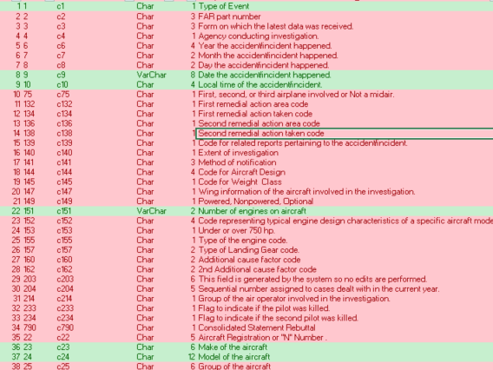
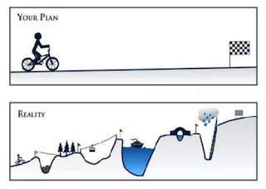
The data, continued
Most of the time I spent on this project involved getting to know the data and trying to make sense of how it could be analyzed
This absolutely was my experience just getting through the data:

Slide 7

The process
I decided to limit the scope of my analysis to one 5-year block of time, which had 180 features and 15,782 observations
I found that I did not need all 180 columns of data so I whittled that down in stages, first to 43 then down to 15
Next, I renamed the columns to plain-language names for ease of analysis
I then conducted some exploratory data analysis and decided to focus on those accidents and incidents that resulted in fatalities and injuries
Next, I attempted to model the data using linear regression and logistic regression, looking for a relationship between the total pilot hours, pilot age, and number of fatalities and injuries
Finally, I looked at the categorical data and built classification decision trees using pilot age, total flight time, and type of pilot certification to determine feature importance on whether or not there were fatailities and injuries
I walked through this basic workflow, with most of my time spent on preparing the data
The Analysis phase proved to be a challenge as well, mostly due to my inexperience with the toolset combined with the challenging data set

Slide 8
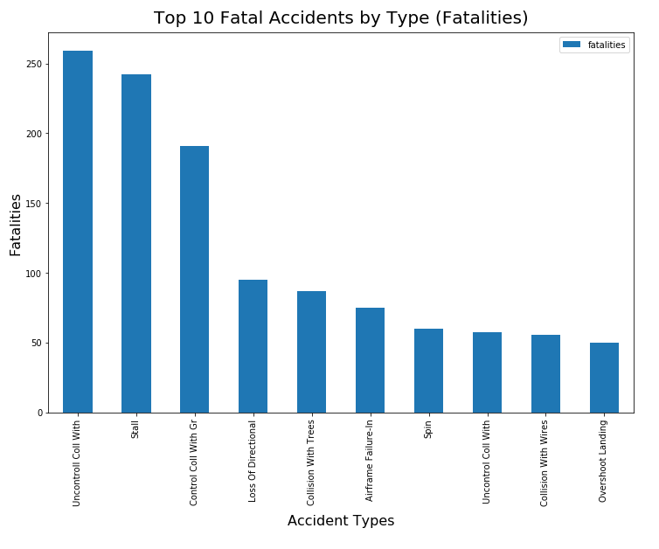
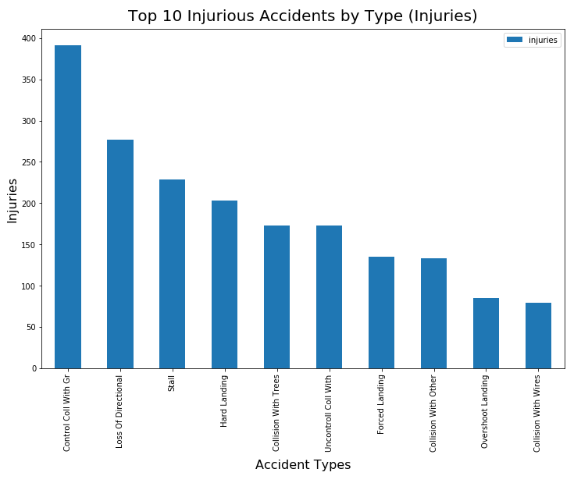
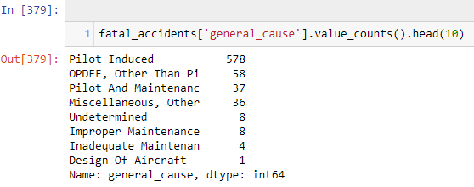
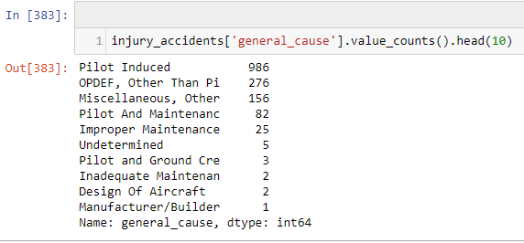
The analysis
Looking at the most fatal types of accidents and the general causes clearly showed that pilot induced factors were the leading cause of fatalities
The same was true for accidents causing injury

Slide 9
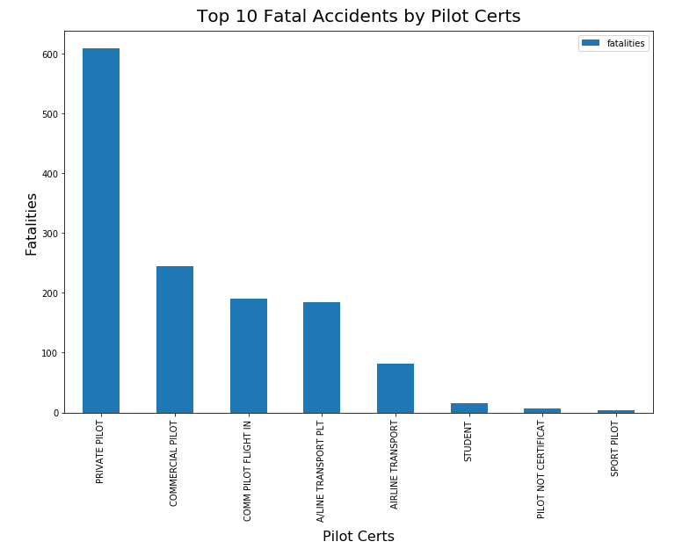
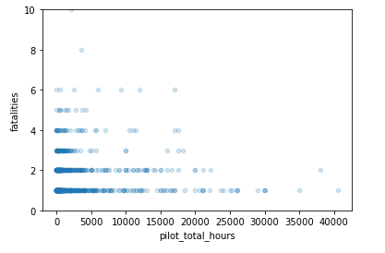
The analysis - continued
The level of pilot experience and training should have an impact on accident rates, as well as the ability to recover from a spin, stall, or other departure from controlled flight that would otherwise be fatal (think: Capt Sullenberger on the Hudson River), so I looked at the level of pilot certification and total flight time
Most of the fatalities occurred when the pilot in command only possessed a private license, vs the more experienced commercial and air transport pilots, even though private pilots carried far fewer crew and passengers.
Pilot total hours also seems to have an effect on the number of accidents resulting in fatalities

Slide 10
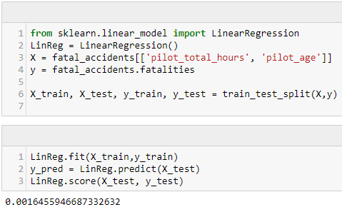
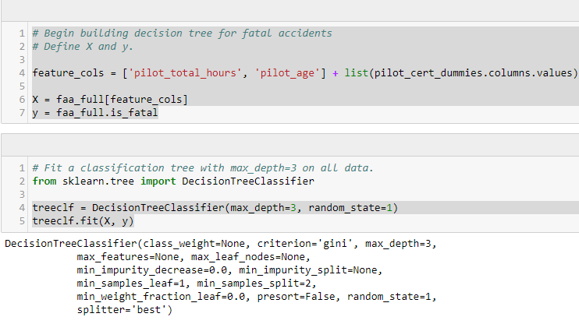
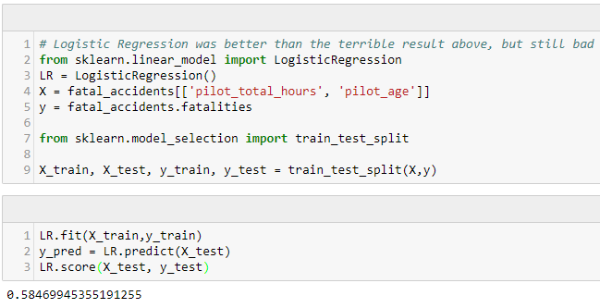
modeling
I ran both a linear and logistic regression on the pilot hours, pilot age, and number of fatalities to see how such a model would score. The answer is – not well.
I then decided to look at building classification trees to analyze the categorical data
I created dummy variables for the types of pilot certifications and ran the decision tree algorithm on pilot hours, pilot age, and certification level
I built trees for both accidents involving fatalities and those involving injuries

Slide 11
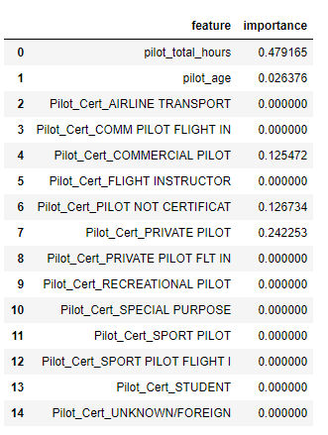
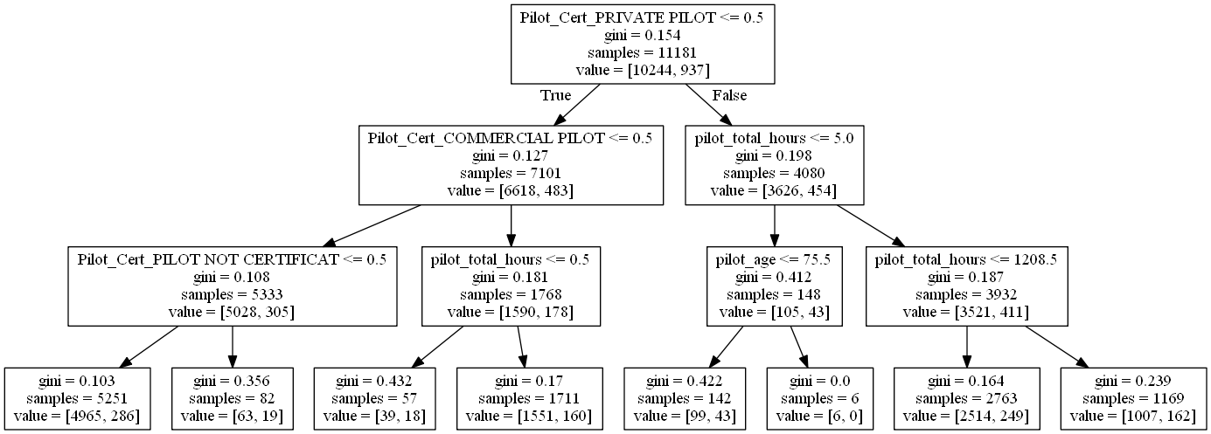
Modeling - continued
The data suggests that pilot experience does matter. I then looked at only pilot hours and age

Slide 12
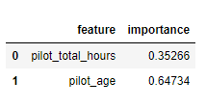
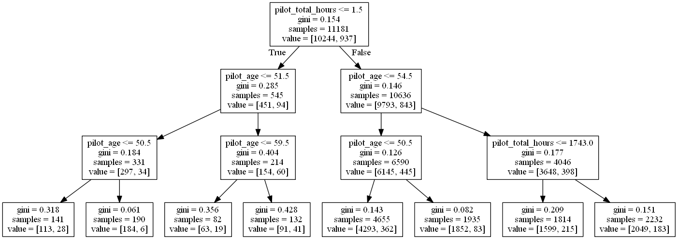
Modeling - continued

